Slide 1
AI-Based Interview Evaluation System
Multi-Modal Machine Learning Approach
Shenbaga ganeshan S
Artificial Intelligence and Data Science

Slide 2
Problem Statement
Traditional interviews rely on human judgment
Evaluation may be subjective and inconsistent
No automated system to analyze:
Communication skills
Confidence level
Emotional behavior

Slide 3
Proposed Solution
Developed an AI-based interview evaluation system
Analyzes candidate using multiple modalities:
Speech (content)
Voice (confidence)
Facial Emotion (behavior)
Generates an overall performance score using ML

Slide 4
System Architecture
Speech Input → Speech-to-Text
↓
Sentence Transformer → Semantic Similarity
↓
Voice Analysis → Confidence Level
↓
Emotion Detection → Facial Expression
↓
ML Model (Random Forest) → Final Score

Slide 5
Technologies Used
Computer Vision:
DeepFace (Emotion Detection)
Natural Language Processing:
Sentence-BERT (Semantic Analysis)
Speech Processing:
SpeechRecognition (Speech-to-Text)
Audio Analysis:
Librosa (Energy & Pitch)
Machine Learning:
Random Forest Regressor
Frontend:
Streamlit + WebRTC

Slide 6
Model & Working
Extracted features:
Semantic similarity score
Voice confidence level
Emotion score
Trained a Random Forest regression model
Model predicts:
Final interview performance score (0–100)

Slide 7
Results & Advantages
Real-time interview evaluation
Multi-modal analysis improves accuracy
Objective and unbiased scoring
Smooth UI using WebRTC
Advantages:
Scalable system
Can be used in recruitment platforms

Slide 8
Conclusion & Future Work
Conclusion:
Successfully built a multi-modal AI interview system
Integrated NLP, Computer Vision, and ML
Future Work:
Use real interview datasets
Improve accuracy using deep learning models
Add AI-based feedback generation

Slide 9
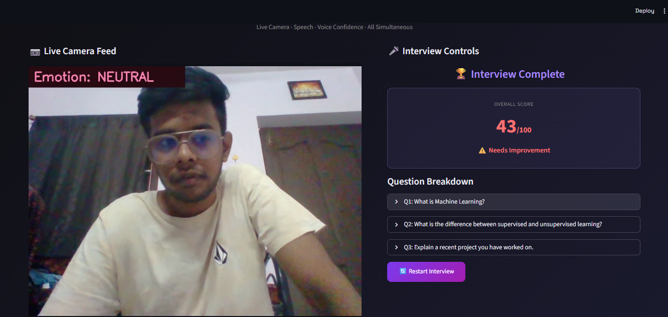
Output & Final Score using Random Forest

